Slide 1
Bond investment strategy
Alper YILDIRIM

Slide 2
Contents
Global Market Outlook
Portfolio Distribution
Portfolio Construction
Risk Considerations
Interest Rate Risk
Laddering
Strategy
Inflation Risk
Credit Risk
Inflation Risk
Geopolitical Risk
Global Diversification
CDS/Yield Arbitrage

Slide 3
Portfolio constructıon

Slide 4
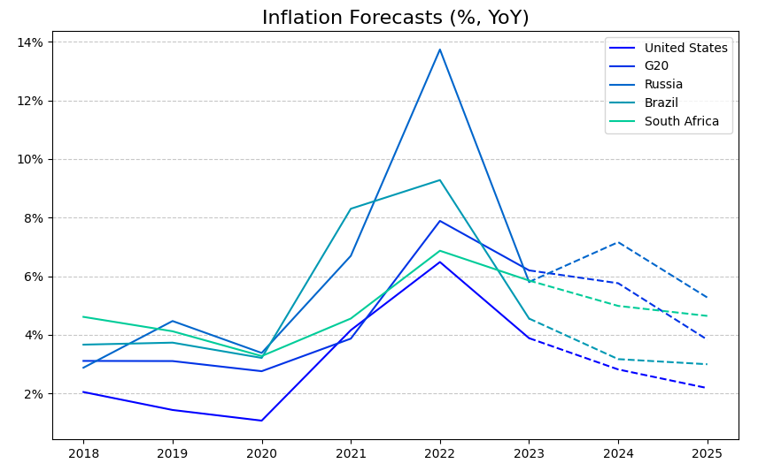
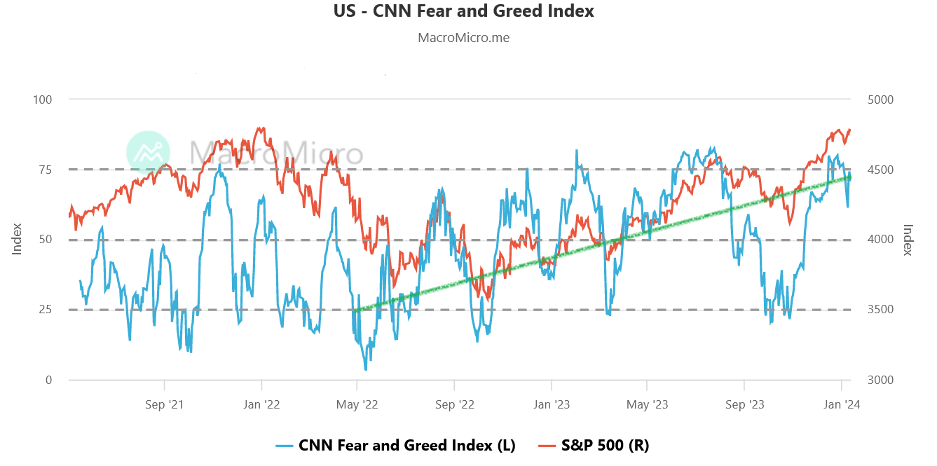
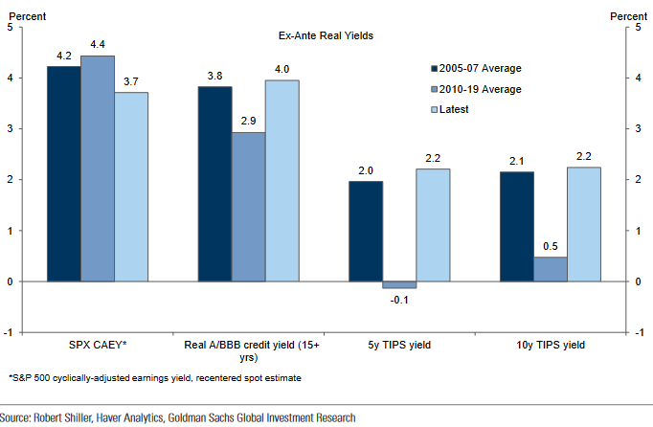
Global market outlook

Slide 5
PORTFOLIO DISTRIBUTION
 | YTM | Price | Maturity | Cpn | Rating
Bond 1 |  |  | 1 |  | AAA
Bond 2 |  |  | 1 |  | AA
Bond 3 |  |  | 1 |  | AA
Bond 4 |  |  | 2 |  | BBB
Bond 5 |  |  | 2 |  | AAA
Bond 6 |  |  | 5 |  | AA
Bond 7 |  |  | 10 |  | BBB
Bond 8 |  |  | 30 |  | BBB
Bond Selection Criteria:
Geographical Diversification
Laddering for Risk Aversion
High Cpn Rate
Summary:
60% US Treasuries
Rating Distribution: AAA : 40% BA : 30%
Portfolio Duration:
DV01:

Slide 6
strategy

Slide 7
PLAN FOR PRODUCT LAUNCH
Deploy strategic networks with compelling e-business needs
PLANNING
Synergize scalable e-commerce
MARKETING
Disseminate standardized metrics
DESIGN
Coordinate e-business applications
Foster holistically superior methodologies
LAUNCH
STRATEGY

Slide 8
RISK CONSIDERATIONS

Slide 9
Interest rate rısk
- duration, convexity, etc.

Slide 10
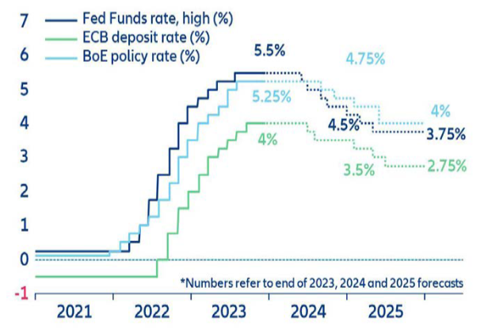
Inflatıon and interest rate rısk
Even though risks persist, inflation started to cool down
Starting from 2nd half of 2024, interest rate cuts may start
Data Source: OECD Economic Outlook, November 2023
Source: Allianz SE, Global Economic Outlook 2023-25

Slide 11
Lıquıdıty rısk

Slide 12
Credıt rısk

Slide 13
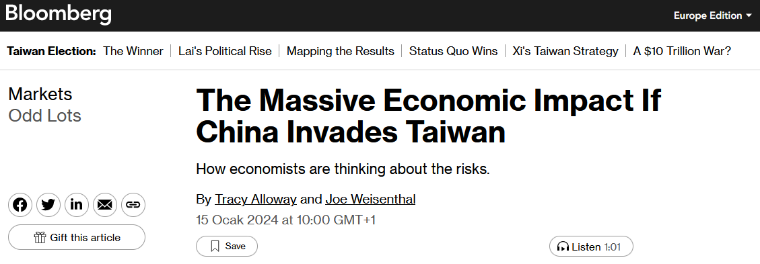
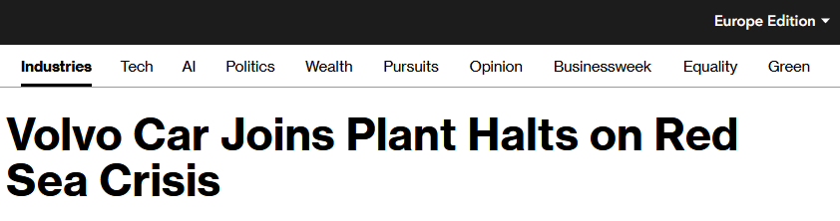
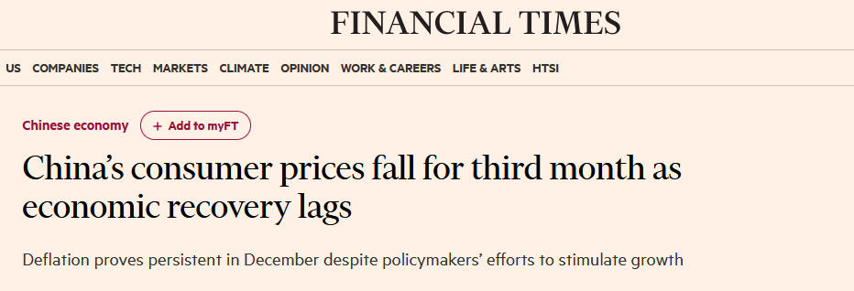
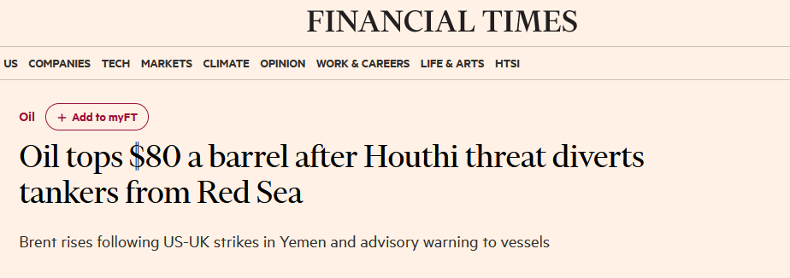
Geopolıtıcal rısk
Avoid Chinese and Middle East Region bonds
Rising political and military tensions may eventually lead economic downturn and declining markets

Slide 14
THANK YOU
Alper Yıldırım
yildirimalper@outlook.de

